Slide 1
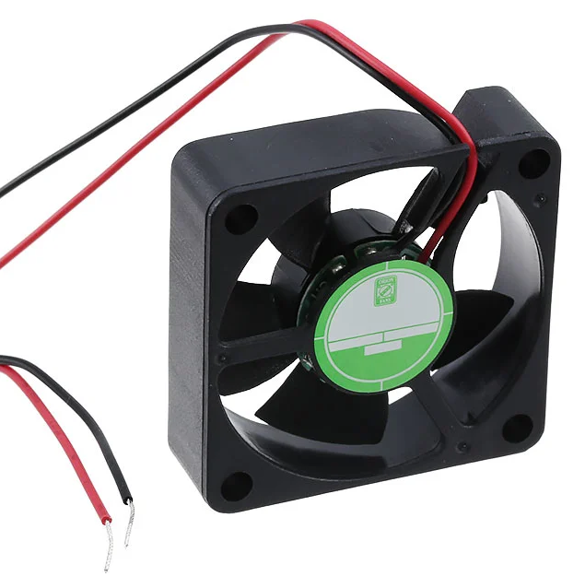
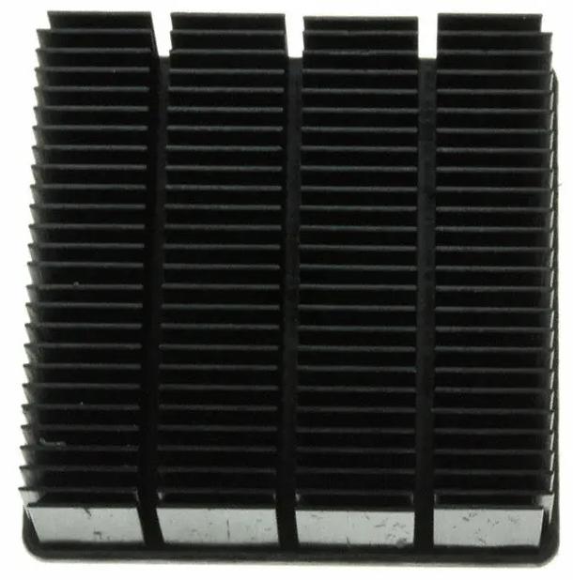
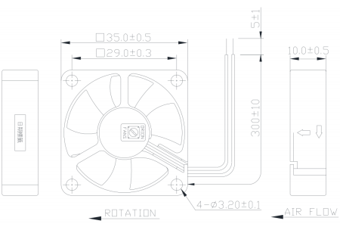
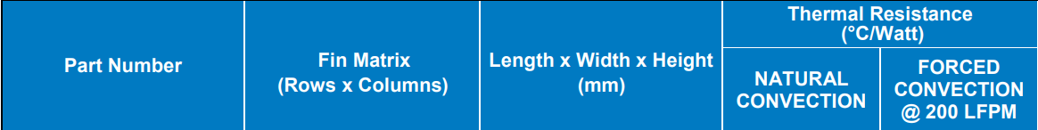
Heatsink Selections – Fan Selection
Link
Link

Slide 2
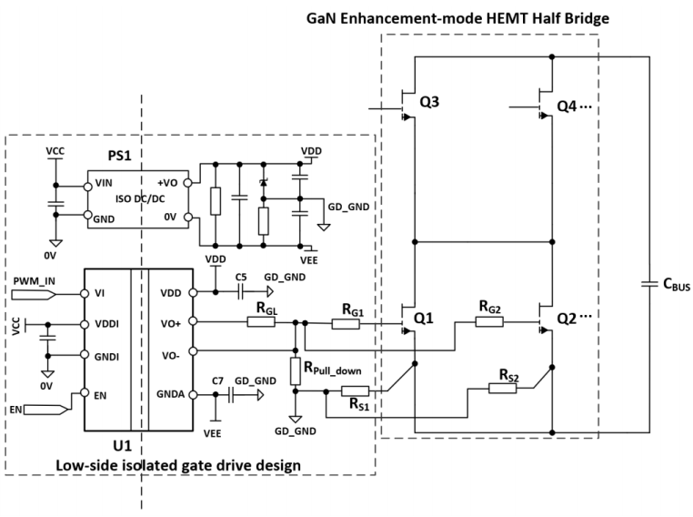
PCB Design – Gate Loop
Resistances to be placed on CSI loops to eliminate unbalance and oscillations

Slide 3
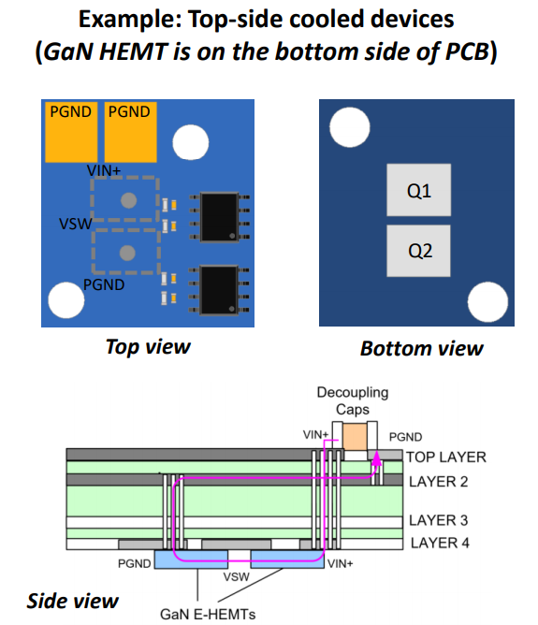
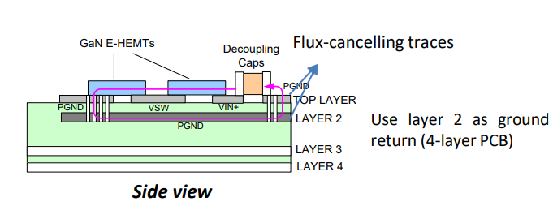
PCB Design – Power Loop
The main concern for top cooled transistors is having bypass capacitors on the top layer because of the heatsink
Positive and negative nets of DC Bus coincide here. Clearence and route width are the concerns
Not possible

